Slide 1
Chapter 20

Slide 2
Objectives

Slide 3
Two constructors for the SqlConnection class

Slide 4
Common values used in the ConnectionString property for SQL Server

Slide 5
Two connection strings for the SQL Server provider

Slide 6
A connection string for the Jet OLE DB provider

Slide 7
Code that creates, opens, and closes a SQL connection

Slide 8
Three constructors for the SqlCommand class

Slide 9
Common properties of the SqlCommand class

Slide 10
CommandType enumeration members

Slide 11
Code that creates a SqlCommand object that executes a Select statement

Slide 12
A SQL Server Select statement that uses a parameter

Slide 13
Four constructors for the SqlParameter class

Slide 14
Code that creates a parameter

Slide 15
Common indexers of the Parameters collection

Slide 16
A statement that adds a parameter to the Parameters collection

Slide 17
Two ways to create a SqlDataReader object

Slide 18
Common members of the SqlDataReader class

Slide 19
Code that uses a data reader to read a list of State objects

Slide 20
Code that creates and executes a command that returns an aggregate value

Slide 21
Code that creates and executes a command that inserts a row

Slide 22
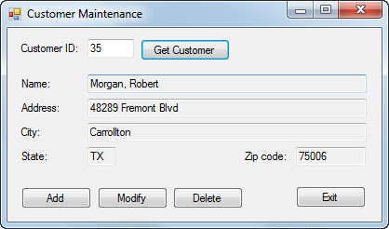
The Customer Maintenance form

Slide 23
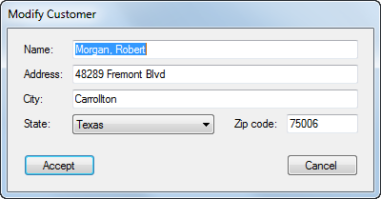
The Add/Modify Customer form

Slide 24
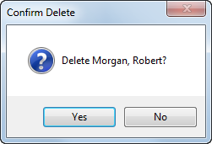
The dialog box that’s displayed to confirm a delete operation

Slide 25
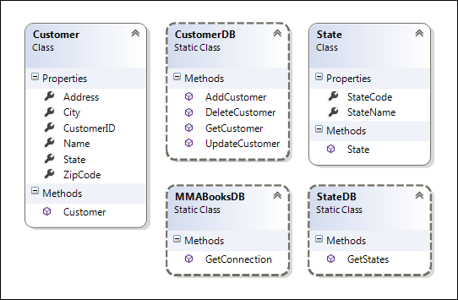
The class diagram

Slide 26
The code for the CustomerDB class

Slide 27
The code for the CustomerDB class (cont.)

Slide 28
The code for the CustomerDB class (cont.)

Slide 29
The code for the CustomerDB class (cont.)

Slide 30
The code for the CustomerDB class (cont.)

Slide 31
The code for the CustomerDB class (cont.)

Slide 32
The code for the CustomerDB class (cont.)

Slide 33
The code for the CustomerDB class (cont.)

Slide 34
The code for the CustomerDB class (cont.)

Slide 35
The code for the StateDB class

Slide 36
The code for the StateDB class (cont.)

Slide 37
The code for the MMABooksDB class

Slide 38
The Customer Maintenance form

Slide 39
The Customer Maintenance form (cont.)

Slide 40
The Customer Maintenance form (cont.)

Slide 41
The Customer Maintenance form (cont.)

Slide 42
The Customer Maintenance form (cont.)

Slide 43
The Customer Maintenance form (cont.)

Slide 44
The Add/Modify Customer form

Slide 45
The Add/Modify Customer form (cont.)

Slide 46
The Add/Modify Customer form (cont.)

Slide 47
The Add/Modify Customer form (cont.)

Slide 48
The Add/Modify Customer form (cont.)

Slide 49
The Add/Modify Customer form (cont.)

Slide 50
Extra 20-1 Write the code for a Product Maintenance application

Slide 51
Project 4-5 Register products

